Slide 1

AutoCAD
ELECTRICAL
COURSE SLIDES · WSQ
Technical Drawing with AutoCAD Electrical
WSQ Course Code: TGS-2023037466
TSC: Technical Drawing · DSN-TDR-4005-1.1
Conducted by Tertiary Infotech Academy Pte Ltd · UEN 201200696W
Version 6.0 · 18 August 2026
Trainer: ______________________ · www.tertiarycourses.com.sg · enquiry@tertiaryinfotech.com · +65 6100 0613
© 2026 Tertiary Infotech Academy Pte Ltd. All rights reserved.

Slide 2
COURSE ADMINISTRATION
Welcome & Housekeeping
Technical Drawing with AutoCAD Electrical · TGS-2023037466
© 2026 Tertiary Infotech Academy Pte Ltd
1

Slide 3
TRAQOM · SSG DIGITAL ATTENDANCE
Digital Attendance (Mandatory)
• It is mandatory to take the AM, PM and Assessment digital attendance for WSQ-funded courses.
• The trainer/administrator displays the digital attendance QR code from the SSG portal.
• Scan the QR code with your mobile phone camera and submit your attendance.
• A minimum of 75% attendance is required to be eligible for assessment and funding.
Technical Drawing with AutoCAD Electrical · TGS-2023037466
© 2026 Tertiary Infotech Academy Pte Ltd
2

Slide 4
YOUR TRAINER · GENERAL
About the Trainer
NAME
____________________________________________
?
TITLE / DESIGNATION
____________________________________________
QUALIFICATIONS
____________________________________________
Your Trainer
AREAS OF EXPERTISE
____________________________________________
General Trainer template — to be completed by the trainer
TRAINING & INDUSTRY EXPERIENCE
____________________________________________
CONTACT
____________________________________________
Technical Drawing with AutoCAD Electrical · TGS-2023037466
© 2026 Tertiary Infotech Academy Pte Ltd
3

Slide 5
YOUR TRAINER
About the Trainer
ROLE
Principal Trainer, Tertiary Infotech Academy Pte Ltd
AA
QUALIFICATIONS
PhD — data science, engineering design and CAD/CAE practice.
Dr Alfred Ang
DELIVERS
WSQ courses on technical drawing (AutoCAD, AutoCAD Electrical, Revit, Fusion 360) and engineering software.
Principal Trainer Tertiary Infotech Academy Pte Ltd
FOUNDER
Founder and lead instructor at Tertiary Infotech / Tertiary Courses.
Technical Drawing with AutoCAD Electrical · TGS-2023037466
© 2026 Tertiary Infotech Academy Pte Ltd
4

Slide 6
ICE-BREAKER
Let's Know Each Other
• Your name and organisation / role.
• Your experience with AutoCAD or electrical design (if any).
• What you want to be able to draw or document after this course.
Technical Drawing with AutoCAD Electrical · TGS-2023037466
© 2026 Tertiary Infotech Academy Pte Ltd
5

Slide 7
HOUSEKEEPING
Ground Rules
Set your mobile phone to silent mode.
Participate actively — no question is stupid.
1
2
Respect each other's views.
Exit silently for calls or toilet breaks.
3
4
Be punctual; return from breaks on time.
75% attendance is required for funding.
5
6
Technical Drawing with AutoCAD Electrical · TGS-2023037466
© 2026 Tertiary Infotech Academy Pte Ltd
6

Slide 8

COURSE PORTAL · LMS/TMS
Download Course Material
• All course materials live on the Tertiary Infotech LMS/TMS portal.
• Portal: https://lms-tms.tertiaryinfotech.com
• Log in with the credentials sent to your registered email.
• Download the slides and Learner Guide — you may use them during the open-book assessment.
• Your attendance records, assessment submission and certificate are also on the portal.
Technical Drawing with AutoCAD Electrical · TGS-2023037466
© 2026 Tertiary Infotech Academy Pte Ltd
7

Slide 9
SCHEDULE · 0930 – 1830 DAILY
Lesson Plan — 2 Days
Day 1
Day 2
• Day 1 — Getting started, projects and schematic drawing
– Digital attendance (AM) · introductions · learning outcomes · course outline
– Topic 1: Introduction to Technical Drawing Using AutoCAD Electrical (Labs 1–2)
– Lunch break · digital attendance (PM)
– Topic 2: Analysing Technical Drawings (Labs 3–4)
– End of Day 1
• Day 2 — Analysis, documentation, submission and assessment
– Digital attendance (AM) · Day 1 recap
– Topic 2 (continued): cross-referencing & review (Lab 5)
– Topic 3: Reviewing Drawings for Strategic Relevance & Standard Compliance (Labs 6–8)
– Course feedback & TRAQOM survey · digital attendance (Assessment)
– Final Assessment: WA (SAQ) 1 hr + PP 1 hr
Technical Drawing with AutoCAD Electrical · TGS-2023037466
© 2026 Tertiary Infotech Academy Pte Ltd
8

Slide 10
WSQ · SKILLS FRAMEWORK
Skills Framework
• TSC Title: Technical Drawing
• TSC Code: DSN-TDR-4005-1.1
• This course is mapped to the Skills Framework for Design — Technical Drawing TSC.
• The assessment covers every Knowledge (K1–K6) and Ability (A1–A6) statement of the TSC.
Technical Drawing with AutoCAD Electrical · TGS-2023037466
© 2026 Tertiary Infotech Academy Pte Ltd
9

Slide 11
DSN-TDR-4005-1.1 · KNOWLEDGE (ASSESSED IN THE WA)
TSC Knowledge Statements
K1
Symbols, standards and conventions used in technical drawings across various fields and regions
K2
Methods of technical drawing by instruments and computer-aided design (CAD) systems
1
2
K3
Types of technical drawings
K4
Technical drawing standards
3
4
K5
Fundamentals of drafting design documentation
K6
Concepts of information technology (IT) to facilitate the usage of technical drawing software
5
6
Technical Drawing with AutoCAD Electrical · TGS-2023037466
© 2026 Tertiary Infotech Academy Pte Ltd
10

Slide 12
DSN-TDR-4005-1.1 · ABILITIES (ASSESSED IN THE PP)
TSC Ability Statements
A1
Devise metrics and guidelines for the production of technical drawings
A2
Formulate solutions for problems encountered during the development of technical drawings
1
2
A3
Review technical drawings for accuracy and adherence to established specifications
A4
Analyse drawings to determine their construction needs to deliver upon design solutions
3
4
A5
Review technical drawings and/or changes to them, to ensure relevance to the organisation's strategies
A6
Review drawings and specifications to ensure conformance to requirements of relevant standards for submission
5
6
Technical Drawing with AutoCAD Electrical · TGS-2023037466
© 2026 Tertiary Infotech Academy Pte Ltd
11

Slide 13
WHAT YOU'LL ACHIEVE
Learning Outcomes
LO1 — Devise & solve
Devise metrics for technical drawing production with AutoCAD Electrical and formulate solutions for development problems. (K1, K2, A1, A2)
1
LO2 — Analyse & review
Analyse technical drawings to determine construction needs while reviewing accuracy and adherence to specifications. (K3, K4, A3, A4)
2
LO3 — Strategy & standards
Review drawings for relevance to the organisation's strategies and conformance to submission standards. (K5, K6, A5, A6)
3
Technical Drawing with AutoCAD Electrical · TGS-2023037466
© 2026 Tertiary Infotech Academy Pte Ltd
12

Slide 14
THREE LEARNING UNITS · EIGHT HANDS-ON LABS
Course Outline
Topic 1 · Introduction
Topic 2 · Analysing Drawings
Topic 3 · Review & Compliance
• AutoCAD Electrical user interface
• Symbols, standards & conventions
• Ribbon, palettes & navigation
• Projects & drawing management
• Labs 1–2
• Types of schematic drawings
• Components, terminals & PLC symbols
• Wires, numbers & signal arrows
• Cross-referencing & review tools
• Labs 3–5
• Drafting design documentation
• Panel layouts & part-list reports
• Custom symbols
• Plot & publish for submission
• Labs 6–8
Technical Drawing with AutoCAD Electrical · TGS-2023037466
© 2026 Tertiary Infotech Academy Pte Ltd
13

Slide 15
BEFORE THE ASSESSMENT
Briefing for Assessment
• Place phones and other materials under the table or on the floor.
• No photos or recording of assessment scripts.
• No discussion during the assessment.
• Use a black/blue pen for hard-copy assessments.
• No liquid paper / correction tape.
• Scripts are collected when time is up.
Technical Drawing with AutoCAD Electrical · TGS-2023037466
© 2026 Tertiary Infotech Academy Pte Ltd
14

Slide 16
FINAL ASSESSMENT · DAY 2
Assessment
• Written Assessment (WA) — Short-Answer Questions (SAQ), 1 hour, open book. (K1–K6)
• Practical Performance (PP) — hands-on AutoCAD Electrical tasks, 1 hour, open book. (A1–A6)
• Format: Open Book — slides, Learner Guide and approved materials only.
• A minimum of 75% attendance is required to be eligible for assessment and funding.
• An appeal process is available if required.
Technical Drawing with AutoCAD Electrical · TGS-2023037466
© 2026 Tertiary Infotech Academy Pte Ltd
15

Slide 17
ON ASSESSMENT DAY
Assessment Flow
1
2
3
4
5
▶
▶
▶
▶
TRAQOM survey — scan the QR code on the LMS
Assessment digital attendance — scan the SSG QR
Sit WA (SAQ) then PP — open book
Submit your answers on the LMS
Sign the Assessment Summary Record
Technical Drawing with AutoCAD Electrical · TGS-2023037466
© 2026 Tertiary Infotech Academy Pte Ltd
16

Slide 18
WSQ FUNDING
Criteria for Funding
• Minimum attendance rate of 75% based on the SSG Digital Attendance record.
• Complete the assessment and be assessed as 'Competent'.
Technical Drawing with AutoCAD Electrical · TGS-2023037466
© 2026 Tertiary Infotech Academy Pte Ltd
17

Slide 19
01
TOPIC 01
Introduction to Technical Drawing Using AutoCAD Electrical
User interface · symbols, standards & conventions · ribbon · navigation · projects & drawings (K1, K2 · A1, A2)
Technical Drawing with AutoCAD Electrical · TGS-2023037466
© 2026 Tertiary Infotech Academy Pte Ltd
18

Slide 20
MAPS TO LO1
Key Concepts — Topic 1
Symbols, standards, conventions
IEEE 315/315A, IEC-60617 and NFPA symbol libraries make an electrical drawing readable across fields and regions. (K1)
CAD vs manual drawing
AutoCAD Electrical automates tagging, wire numbering and cross-referencing that instrument drawing does by hand. (K2)
1
2
The AutoCAD Electrical UI
Ribbon tabs, Quick Access Toolbar, marking menu, palettes, status bar, command line and navigation tools.
Projects drive everything
A .wdp project file groups interrelated drawings so project-wide functions can retag, renumber and report.
3
4
Devise metrics & guidelines
Templates, drawing properties, reference systems and title blocks standardise production. (A1)
Formulate solutions
Grid/snap, ortho, object snap and the Circuit Clipboard solve day-to-day drawing development problems. (A2)
5
6
Technical Drawing with AutoCAD Electrical · TGS-2023037466
© 2026 Tertiary Infotech Academy Pte Ltd
19

Slide 21
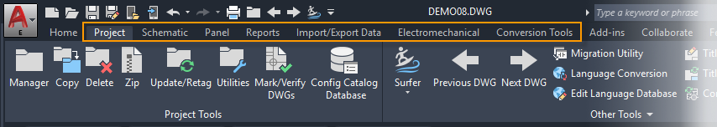
TOPIC 01 · USER INTERFACE · K2
Ribbon Tabs and Panels
• AutoCAD Electrical presents a standard tabbed ribbon across the top of the drawing area.
• Electrical-specific tabs (Schematic, Panel, Reports) sit alongside the core AutoCAD tabs.
• Each tab is divided into panels that group related commands.
• Right-click in the tabs area to choose which tabs and panels to display or hide.
Technical Drawing with AutoCAD Electrical · TGS-2023037466
© 2026 Tertiary Infotech Academy Pte Ltd
20

Slide 22
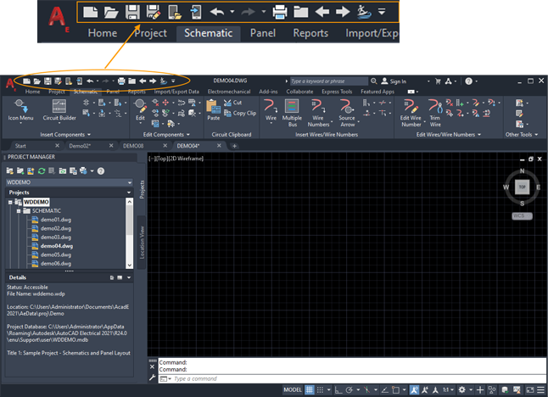
TOPIC 01 · USER INTERFACE · K2
Quick Access Toolbar
• The Quick Access Toolbar keeps New, Open, Save, Plot and Undo one click away.
• It also carries navigation commands used frequently in AutoCAD Electrical.
• Customise it: click the drop-down at its right end and tick the commands you use most.
Technical Drawing with AutoCAD Electrical · TGS-2023037466
© 2026 Tertiary Infotech Academy Pte Ltd
21

Slide 23
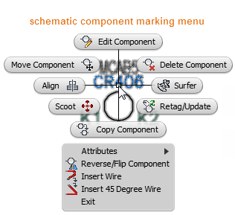
TOPIC 01 · USER INTERFACE · K2
Marking Menu
• The marking menu is a radial context menu: hover an electrical object and right-click.
• The options shown depend on the type of object under the cursor — click one to run it.
• Power use: press-and-hold right-click, move the cursor toward the desired option, release — a gesture runs the command directly.
Technical Drawing with AutoCAD Electrical · TGS-2023037466
© 2026 Tertiary Infotech Academy Pte Ltd
22

Slide 24
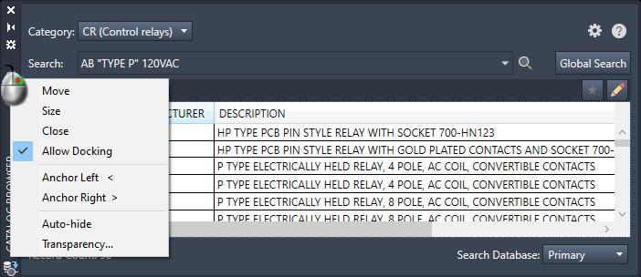
TOPIC 01 · USER INTERFACE · K2
Palettes
• Palettes manage projects (Project Manager) and the catalog database (Catalog Browser).
• A palette stays on screen while other commands run — always accessible.
• Dock, resize or set auto-hide to control how much drawing space a palette uses.
Technical Drawing with AutoCAD Electrical · TGS-2023037466
© 2026 Tertiary Infotech Academy Pte Ltd
23

Slide 25
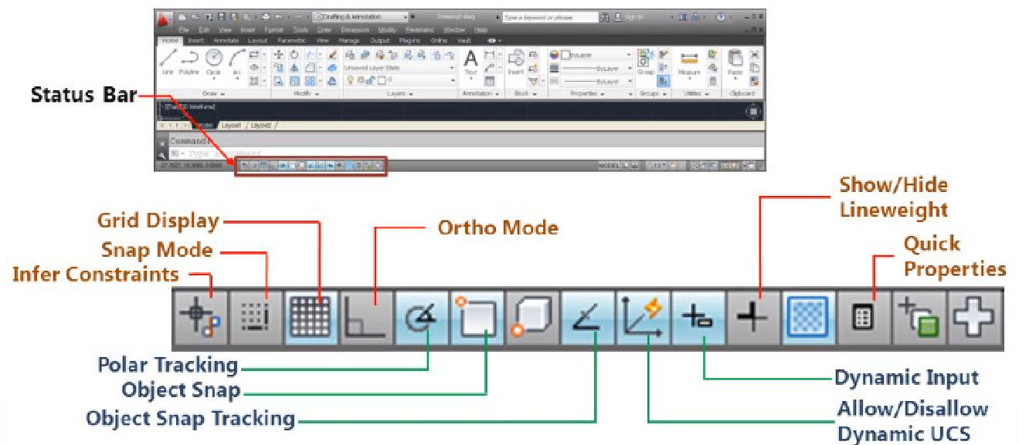
TOPIC 01 · DEVISE METRICS · A1
Status Bar — Precision Settings
• The status bar toggles the settings that make a drawing accurate and precise.
• Grid (F7) displays the reference grid; Snap (F9) locks the cursor to grid points.
• Ortho (F8) constrains movement to horizontal/vertical; Polar tracks set angles.
• 2D Object Snap (F3) jumps to endpoints, midpoints and circle centres as you draw.
• These settings are your first production metric: set them before you draw.
Technical Drawing with AutoCAD Electrical · TGS-2023037466
© 2026 Tertiary Infotech Academy Pte Ltd
24

Slide 26
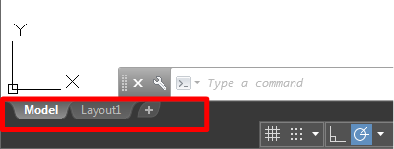
TOPIC 01 · DRAWING ENVIRONMENTS · K2
Model Space and Paper Space
• Model space is a limitless drawing area where you draw at 1:1 real-world size.
• First decide what one unit represents (1 mm, 1 cm, 1 inch …) — then draw to that scale.
• Paper space (layouts) arranges scaled views of the model on a titled sheet for plotting.
Technical Drawing with AutoCAD Electrical · TGS-2023037466
© 2026 Tertiary Infotech Academy Pte Ltd
25

Slide 27
TOPIC 01 · USER INTERFACE · K2
Command Line
• The Command window accepts commands and system variables and prompts you through each command sequence.
• Every ribbon click has a typed equivalent — experienced drafters mix both.
• Ctrl+9 toggles the command window display.
• Watch the prompts: they tell you exactly what input the command expects next.
Technical Drawing with AutoCAD Electrical · TGS-2023037466
© 2026 Tertiary Infotech Academy Pte Ltd
26

Slide 28
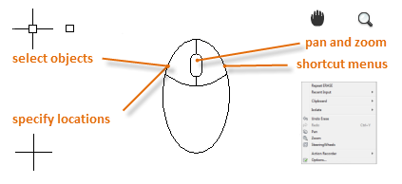
TOPIC 01 · VIEW CONTROL · K2
Navigation Tools
• Pan moves the view parallel to the screen; Zoom changes magnification; Orbit rotates 3D views.
• Mouse shortcuts: press the scroll wheel to Pan, roll it to Zoom, double-click it to Zoom Extents.
• ZOOM (Z) options: All shows everything, Window zooms a picked area, Previous restores up to 10 earlier views, Scale magnifies by factor.
Technical Drawing with AutoCAD Electrical · TGS-2023037466
© 2026 Tertiary Infotech Academy Pte Ltd
27

Slide 29
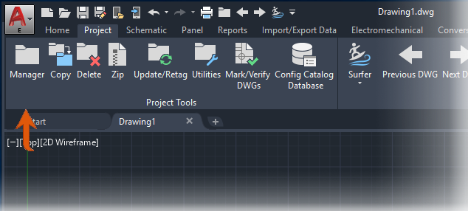
TOPIC 01 · PROJECT-BASED CAD · A1
Projects — the .wdp File
• AutoCAD Electrical is project-based: a project is a set of interrelated drawings.
• All project information — including the drawing list — is saved in a .wdp project file.
• Project Manager creates, opens and manages projects and their settings.
• Working project-wide is what lets tags, wire numbers and cross-references stay consistent.
Technical Drawing with AutoCAD Electrical · TGS-2023037466
© 2026 Tertiary Infotech Academy Pte Ltd
28

Slide 30
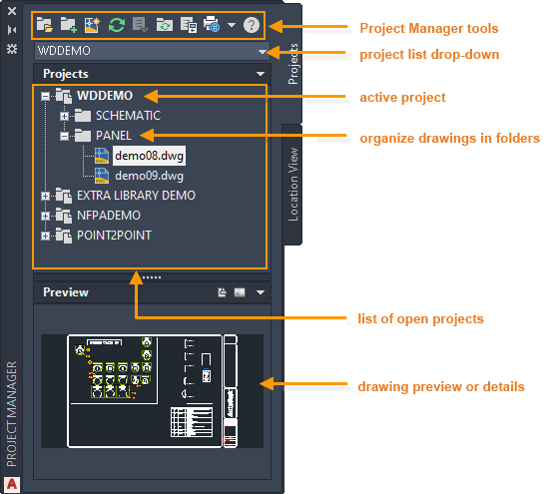
TOPIC 01 · PROJECT-BASED CAD · A1
Project Manager
• Project Manager is a palette — it can stay on screen while you use other commands.
• It can be docked, resized and set to auto-hide.
• Create a project and the .wdp file lands in your chosen folder; the new project becomes active and you add drawings to it.
Technical Drawing with AutoCAD Electrical · TGS-2023037466
© 2026 Tertiary Infotech Academy Pte Ltd
29

Slide 31
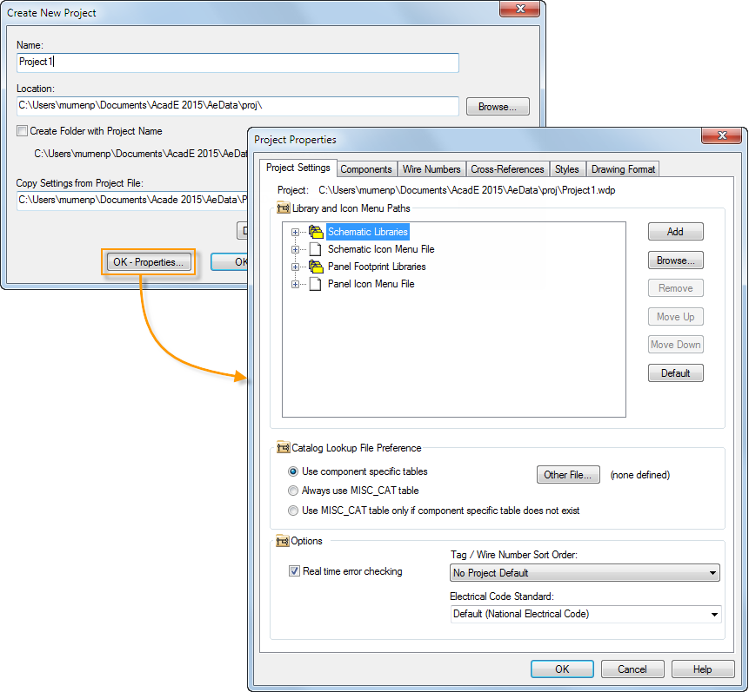
TOPIC 01 · DEVISE GUIDELINES · A1
Project Properties
• Define library paths, drawing format and reference style when you start a project — or any time later.
• Two kinds of properties: drawing defaults (copied into each new drawing) and project-wide settings.
• Setting properties once at project level is how an organisation standardises its drawings.
Technical Drawing with AutoCAD Electrical · TGS-2023037466
© 2026 Tertiary Infotech Academy Pte Ltd
30

Slide 32
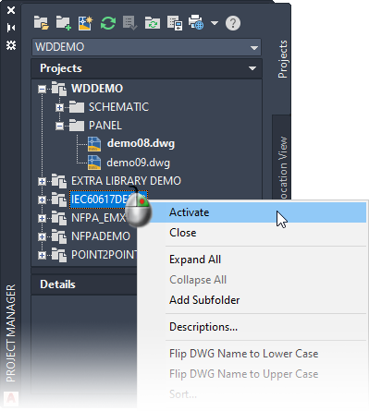
TOPIC 01 · PROJECT-BASED CAD
Activate a Project
• Activate from the list of open projects in Project Manager.
• Or browse to the project's .wdp file, or pick from the recent-projects list.
• An opened project joins the Project Manager list and becomes the active project.
• Copy an existing project to reuse its properties, drawings and support files in a new job.
Technical Drawing with AutoCAD Electrical · TGS-2023037466
© 2026 Tertiary Infotech Academy Pte Ltd
31

Slide 33
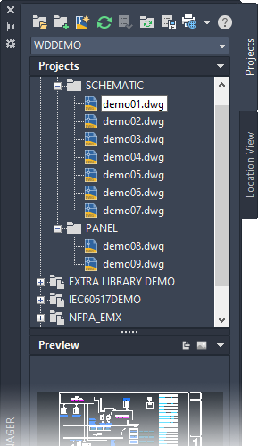
TOPIC 01 · DRAWING MANAGEMENT
Drawings in a Project
• The drawing order sets the processing order for project-wide functions — drag and drop to reorder.
• Add folders within a project to organise drawings.
• New Drawing creates a drawing inside the active project; give it a template with predefined electrical properties, wire layers, a reference system and a title block.
Technical Drawing with AutoCAD Electrical · TGS-2023037466
© 2026 Tertiary Infotech Academy Pte Ltd
32

Slide 34
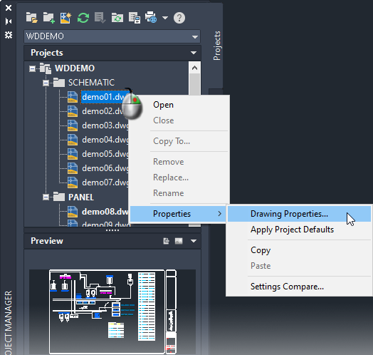
TOPIC 01 · DEVISE METRICS · A1
Drawing Properties
• Drawing Properties control tagging and referencing per sheet: sheet values, installation and location codes.
• Reference system: ladder, X-Y Grid or X Zones; formats for component tags, wire numbers and cross-references.
• Styles: PLC modules, wire crossing and wire connection appearance.
• Properties come from the template or the project defaults — override via OK-Properties when creating the drawing.
Technical Drawing with AutoCAD Electrical · TGS-2023037466
© 2026 Tertiary Infotech Academy Pte Ltd
33

Slide 35
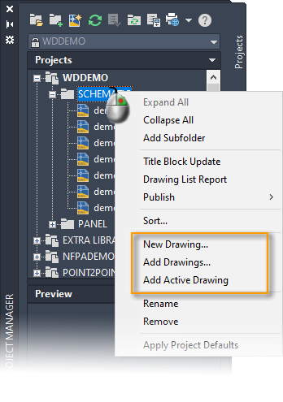
TOPIC 01 · REUSE · A2
Copy and Add Drawings
• Copy a single drawing from any open project into the active project via Project Manager.
• Add existing drawings any time — the way to reuse sheets from a previous job.
• After adding, run Project-Wide Update/Retag to refresh ladder references, component tags, wire numbers and cross-references.
Technical Drawing with AutoCAD Electrical · TGS-2023037466
© 2026 Tertiary Infotech Academy Pte Ltd
34

Slide 36
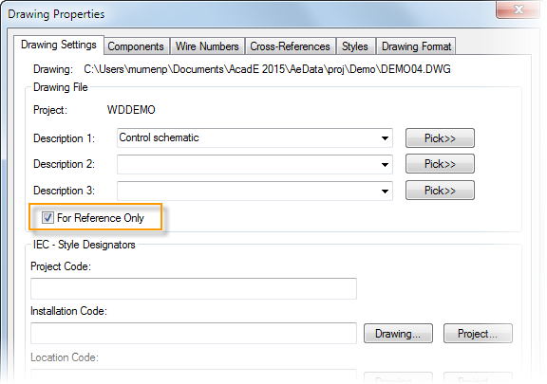
TOPIC 01 · DRAWING MANAGEMENT
Reference-Only Drawings
• Some drawings belong to the project but must not be processed by project-wide functions.
• Mark them Reference Only in the drawing properties — tagging, cross-referencing and reporting skip them.
• Typical examples: cover sheets, general notes, mechanical outlines.
Technical Drawing with AutoCAD Electrical · TGS-2023037466
© 2026 Tertiary Infotech Academy Pte Ltd
35

Slide 37
TOPIC 01 · STANDARDS · K1
Title Block Setup
• Insert a .dwg as the title block and link project/drawing property values to its attributes.
• Title Block Setup creates and defines the mapping between properties and attributes.
• Once mapped, sheet number, description and revision fill in automatically on every sheet — a core drafting standard.
Technical Drawing with AutoCAD Electrical · TGS-2023037466
© 2026 Tertiary Infotech Academy Pte Ltd
36

Slide 38
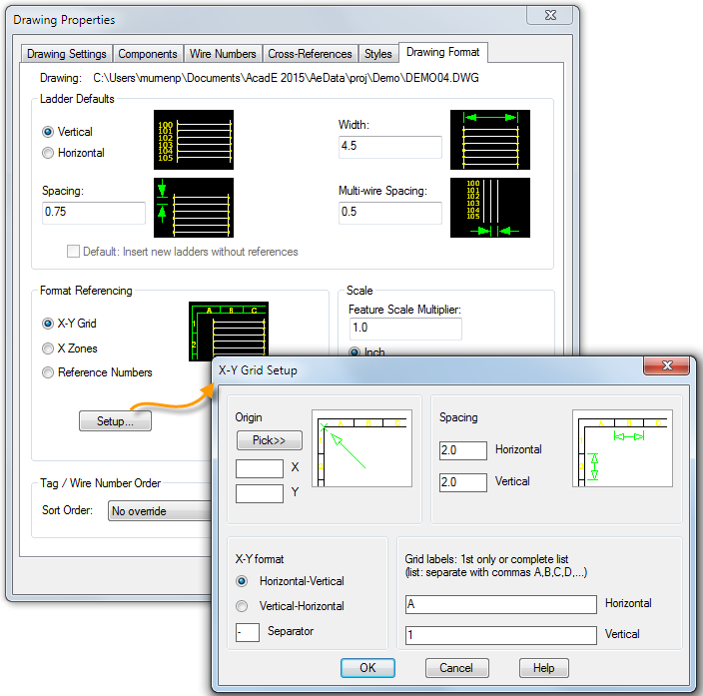
TOPIC 01 · STANDARDS · K1 K4
Reference Systems — Ladders, X-Y Grid, X Zones
• Each schematic drawing can define a reference system: ladder rungs, X-Y grid or X zones.
• The reference system assigns unique component tags and wire numbers (unless sequential tagging is used).
• It also drives cross-referencing between parents and children.
• Insert the ladder or grid from Schematic → Insert Wires/Wire Numbers; define it on a template to save time.
Technical Drawing with AutoCAD Electrical · TGS-2023037466
© 2026 Tertiary Infotech Academy Pte Ltd
37

Slide 39
WHAT YOU'LL DO
Hands-On Labs — Topic 1
Lab 1
Lab 2
• Set Up a New AutoCAD Electrical Drawing
• A correctly configured metric drawing sheet, saved as a reusable baseline for the rest of the course.
• Create a Project with Project Manager
• A working .wdp project containing the supplied power and lighting plan drawings plus a title block, in the correct sheet order.
Technical Drawing with AutoCAD Electrical · TGS-2023037466
© 2026 Tertiary Infotech Academy Pte Ltd
38

Slide 40
TOPIC 01 · HANDS-ON
Set Up a New AutoCAD Electrical Drawing
LAB 1
Create a new drawing from the ACADISO template, then set the workspace, drawing limits and units — the production metrics every drawing in your organisation should start from.
You'll build
A correctly configured metric drawing sheet, saved as a reusable baseline for the rest of the course.
Tools: AutoCAD Electrical · ACADISO template · Status bar · Grid & Snap
Technical Drawing with AutoCAD Electrical · TGS-2023037466
© 2026 Tertiary Infotech Academy Pte Ltd
39

Slide 41
LAB 1 · STEP BY STEP
STEPS 1–4 OF 6
Set Up a New AutoCAD Electrical Drawing
Start AutoCAD Electrical and create a new drawing from the ACADISO template (New → acadiso.dwt).
NEW → acadiso.dwt
1
Set the Electrical workspace from the Workspace Switching control on the status bar.
WSCURRENT → Electrical
2
Set the drawing limits to an A3 metric sheet (0,0 to 420,297) and Zoom All to see the full sheet.
LIMITS 0,0 420,297 then ZOOM All
3
Set the units to decimal millimetres with 0 precision (Format → Units).
UNITS → Decimal · 0
4
Technical Drawing with AutoCAD Electrical · TGS-2023037466
© 2026 Tertiary Infotech Academy Pte Ltd
40

Slide 42
LAB 1 · STEP BY STEP
STEPS 5–6 OF 6
Set Up a New AutoCAD Electrical Drawing
Turn on Grid (F7) and Snap (F9) from the status bar and open DraftingSettings.dwg to compare a pre-configured sheet.
5
GRID 10 · SNAP 10
Save the drawing as MyBaseline.dwg — this is your production guideline drawing.
6
SAVEAS MyBaseline.dwg
Technical Drawing with AutoCAD Electrical · TGS-2023037466
© 2026 Tertiary Infotech Academy Pte Ltd
41

Slide 43
LAB 1 · VERIFY
Set Up a New AutoCAD Electrical Drawing
✅ Test it
ZOOM All shows the full 420×297 sheet, the crosshair snaps in 10 mm increments, and STATUS reports decimal units — your baseline metrics are in force.
Technical Drawing with AutoCAD Electrical · TGS-2023037466
© 2026 Tertiary Infotech Academy Pte Ltd
42

Slide 44
TOPIC 01 · HANDS-ON
Create a Project with Project Manager
LAB 2
AutoCAD Electrical is project-based: a .wdp project groups interrelated drawings so project-wide functions can retag and renumber. Create a project, add the supplied electrical plan drawings, and reorder them.
You'll build
A working .wdp project containing the supplied power and lighting plan drawings plus a title block, in the correct sheet order.
Tools: Project Manager · .wdp project file · Power_Plan / Lighting_Plan DWGs
Technical Drawing with AutoCAD Electrical · TGS-2023037466
© 2026 Tertiary Infotech Academy Pte Ltd
43

Slide 45
LAB 2 · STEP BY STEP
STEPS 1–4 OF 6
Create a Project with Project Manager
Open Project Manager from the Project tab (it is a palette — dock it on the left).
AEPROJECT
1
Create a new project named TRAINING — the .wdp file stores the project description and settings.
Project Manager → New Project → TRAINING
2
Review the Project Properties: library standard (IEC/IEEE/NFPA), component tag format and cross-reference style.
Right-click project → Properties
3
Add the supplied drawings 10-2_Power_Plan.dwg and 10-2_Lighting_Plan.dwg to the project.
Right-click project → Add Drawings
4
Technical Drawing with AutoCAD Electrical · TGS-2023037466
© 2026 Tertiary Infotech Academy Pte Ltd
44

Slide 46
LAB 2 · STEP BY STEP
STEPS 5–6 OF 6
Create a Project with Project Manager
Drag and drop the drawings inside Project Manager so the power plan is sheet 1, and add Title_Block.dwg as reference-only.
5
Drag to reorder · Properties → Reference Only
Make TRAINING the active project and open a drawing from the project list by double-clicking it.
6
Right-click → Activate
Technical Drawing with AutoCAD Electrical · TGS-2023037466
© 2026 Tertiary Infotech Academy Pte Ltd
45

Slide 47
LAB 2 · VERIFY
Create a Project with Project Manager
✅ Test it
Project Manager shows TRAINING in bold (active) with the drawings in your chosen order, and the .wdp file exists in the project folder — project-wide functions now see every sheet.
Technical Drawing with AutoCAD Electrical · TGS-2023037466
© 2026 Tertiary Infotech Academy Pte Ltd
46

Slide 48
TOPIC RECAP
Recap — Topic 1
• A1 — devise metrics and guidelines for technical drawing production (template, workspace, limits, units) (Lab 1)
• A1, A2 — standardise production with a project; solve multi-drawing organisation problems (Lab 2)
• Key concepts: Symbols, standards, conventions, CAD vs manual drawing, The AutoCAD Electrical UI, Projects drive everything, Devise metrics & guidelines, Formulate solutions.
Technical Drawing with AutoCAD Electrical · TGS-2023037466
© 2026 Tertiary Infotech Academy Pte Ltd
47

Slide 49
Lunch Break
Back at 1245 · PM digital attendance

Slide 50
02
TOPIC 02
Analysing Technical Drawings
Types of schematic drawings · components, terminals & PLC symbols · wires & part lists · accuracy review (K3, K4 · A3, A4)
Technical Drawing with AutoCAD Electrical · TGS-2023037466
© 2026 Tertiary Infotech Academy Pte Ltd
49

Slide 51
MAPS TO LO2
Key Concepts — Topic 2
Types of technical drawings
Schematics, panel layouts, wiring diagrams, one-line diagrams and reference-only sheets each serve a construction purpose. (K3)
Technical drawing standards
Ladder references, X-Y grids, wire-number formats and cross-reference styles are the standards drawings are checked against. (K4)
1
2
Schematic components
Insert from the icon menu or catalog database; annotate with tags, descriptions and catalog data.
Terminals & PLC symbols
Standard part lists rely on terminal strips and parametric PLC I/O modules that adapt to the ladder.
3
4
Wires, numbers & arrows
Wire layers, wire numbers and source/destination signal arrows carry the circuit across sheets.
Review for accuracy
Cross-referencing, Surfer and Mark/Verify audit a drawing set for accuracy and adherence to specifications. (A3, A4)
5
6
Technical Drawing with AutoCAD Electrical · TGS-2023037466
© 2026 Tertiary Infotech Academy Pte Ltd
50

Slide 52
TOPIC 02 · DRAWING TYPES · K3
Types of Technical Drawings
• Schematic diagrams show circuit logic: ladders, components, wires and signals.
• Panel layout drawings show the physical arrangement of components in an enclosure.
• Wiring / connection diagrams document point-to-point conductor runs and terminal strips.
• One-line (single-line) diagrams summarise power distribution at system level.
• Reference-only sheets (covers, notes, outlines) support the set without carrying circuit data.
• Each type answers a different construction need — a full drawing set uses them together.
Technical Drawing with AutoCAD Electrical · TGS-2023037466
© 2026 Tertiary Infotech Academy Pte Ltd
51

Slide 53
TOPIC 02 · SCHEMATICS · K4
Schematic Components — Grid and Snap Discipline
• Insert schematic components, generate PLC modules, and insert or copy circuits.
• Work with grid lines on and snap-to-grid when inserting components.
• GRID sets grid spacing; SNAP sets snap spacing; F7 toggles grid visibility, F9 toggles snap.
• Consistent snap spacing keeps rungs aligned so wires connect cleanly — an accuracy standard.
Technical Drawing with AutoCAD Electrical · TGS-2023037466
© 2026 Tertiary Infotech Academy Pte Ltd
52

Slide 54
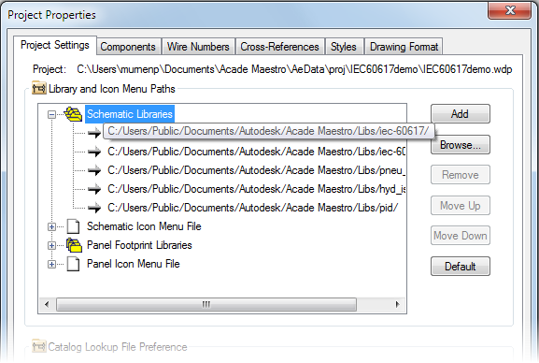
TOPIC 02 · STANDARDS · K1
Symbol Library Standards
• AutoCAD Electrical ships symbol libraries complying with IEEE 315/315A, IEC-60617 and NFPA.
• IEEE and IEC libraries are metric; NFPA library symbols are in inches (scale with the Modify-library utility).
• The old JIC standard was absorbed into NFPA 79; JIC and older IEC libraries remain for legacy support.
• Pick ONE standard per project in Project Properties — mixing standards breaks readability across regions.
Technical Drawing with AutoCAD Electrical · TGS-2023037466
© 2026 Tertiary Infotech Academy Pte Ltd
53

Slide 55
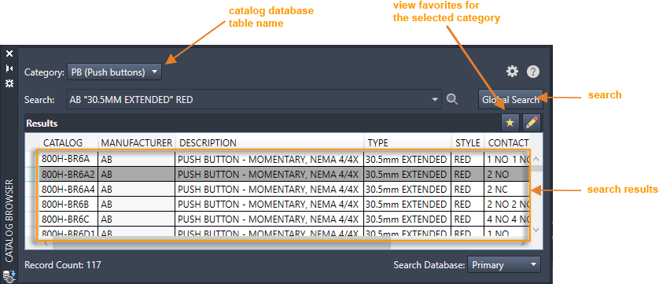
TOPIC 02 · COMPONENTS
Insert a Component from the Catalog Database
• Know the part number already? Insert the component straight from the catalog database.
• Use the Catalog Browser palette; search values are saved for quick reuse.
• Catalog information lands on the symbol automatically; edit further in the Insert/Edit dialog that follows insertion.
Technical Drawing with AutoCAD Electrical · TGS-2023037466
© 2026 Tertiary Infotech Academy Pte Ltd
54

Slide 56
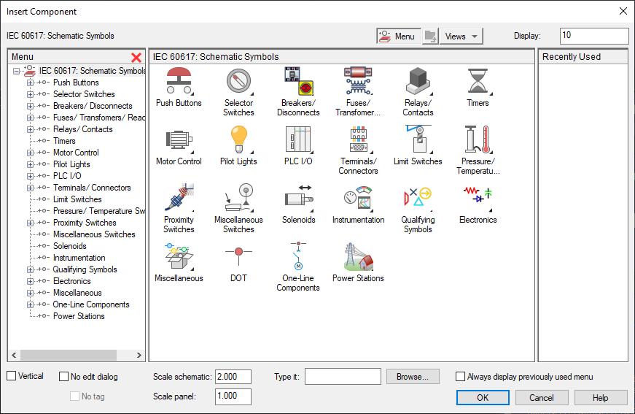
TOPIC 02 · COMPONENTS
Insert a Component from the Icon Menu
• The icon menu inserts by symbol type — a NO push button, a 3-position selector switch, and so on.
• Different icon menus exist per library set; choose the project's icon menu under Project Settings.
• After insertion, annotate with descriptions and catalog information.
Technical Drawing with AutoCAD Electrical · TGS-2023037466
© 2026 Tertiary Infotech Academy Pte Ltd
55

Slide 57
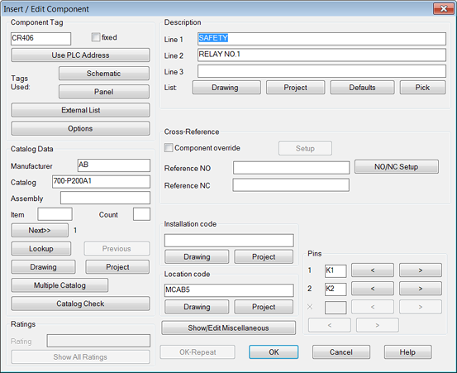
TOPIC 02 · COMPONENT DATA · A3
Annotate the Symbol
• Each symbol carries a main catalog value plus optional multiple-catalog values.
• Edit a component to add, change or remove catalog assignments — Lookup opens the catalog search.
• Multiple Catalog attaches auxiliary parts (contact blocks, adapters) to the same device.
• Complete, accurate annotation is what makes reports and BOMs trustworthy downstream.
Technical Drawing with AutoCAD Electrical · TGS-2023037466
© 2026 Tertiary Infotech Academy Pte Ltd
56

Slide 58
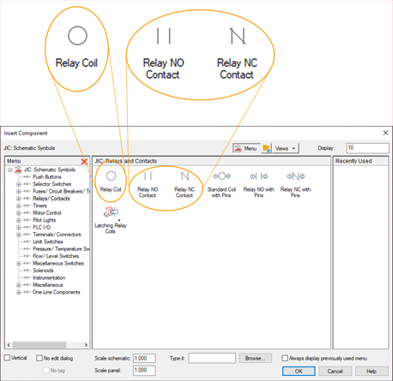
TOPIC 02 · COMPONENT MODEL · K4
Parent and Child Components
• Some devices are drawn as several symbols — a relay is a coil plus its contact symbols.
• The coil is the parent; contacts are children that inherit its tag and data.
• When inserting a child, pick its parent from the active drawing or project list in the Insert/Edit Child dialog.
• Parent/child links power the cross-reference grid you will read in every review.
Technical Drawing with AutoCAD Electrical · TGS-2023037466
© 2026 Tertiary Infotech Academy Pte Ltd
57

Slide 59
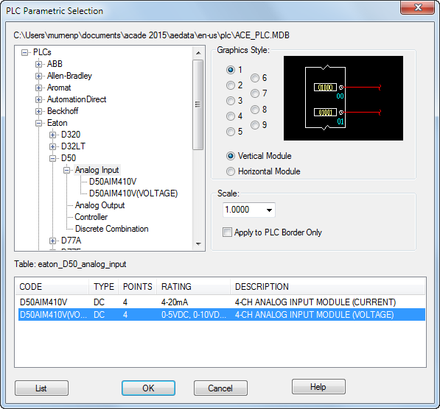
TOPIC 02 · PLC SYMBOLS · K3
PLC I/O Modules
• AutoCAD Electrical generates hundreds of PLC I/O modules on demand, in multiple graphical styles.
• Modules adapt automatically to the underlying ladder rung spacing.
• Expand manufacturer → series → type, pick the module and style, then place it by insertion point.
• Parametric generation keeps PLC drawings consistent with the wiring standard in force.
Technical Drawing with AutoCAD Electrical · TGS-2023037466
© 2026 Tertiary Infotech Academy Pte Ltd
58

Slide 60
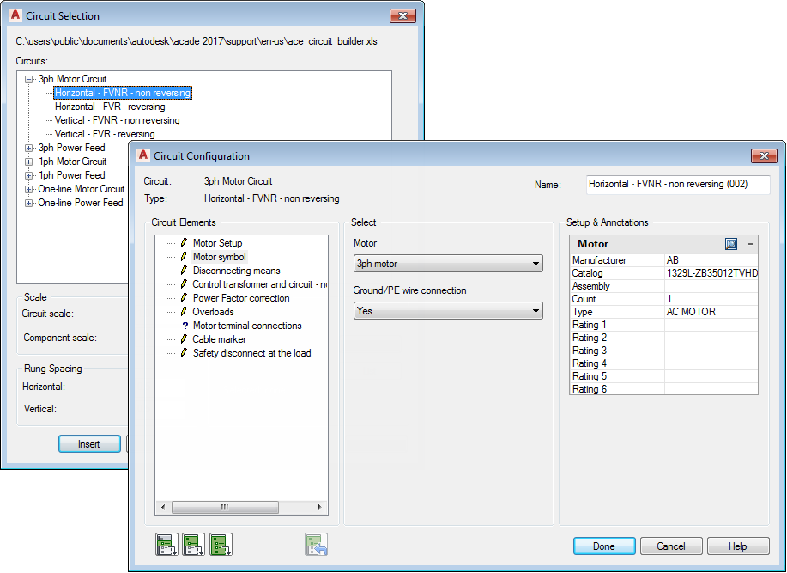
TOPIC 02 · REUSE · A4
Circuits and Circuit Builder
• A circuit is any collection of components and wires; save frequently used circuits to the icon menu.
• A saved circuit re-inserts with tags updating automatically to stay unique.
• Circuit Builder assembles motor-control and power-feed circuits dynamically from your dialog selections.
• Building from proven circuits is how construction needs are met quickly and correctly.
Technical Drawing with AutoCAD Electrical · TGS-2023037466
© 2026 Tertiary Infotech Academy Pte Ltd
59

Slide 61
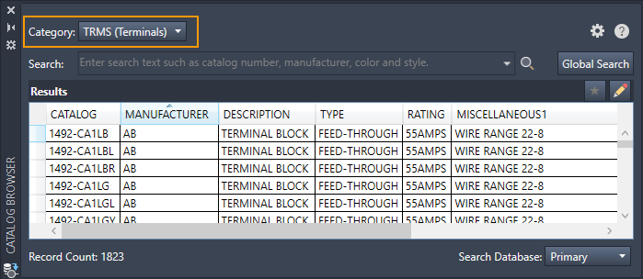
TOPIC 02 · TERMINALS · K3
Schematic Terminals
• Insert terminals like other schematic symbols — from the Catalog Browser (TRMS category) or the icon menu.
• Four terminal behaviour types exist; the terminal block name controls the behaviour.
• Pick the behaviour type and terminal style carefully when inserting from the icon menu.
• The TERMINAL STRIP command inserts strip symbols using Installation, Location and Tagstrip values.
Technical Drawing with AutoCAD Electrical · TGS-2023037466
© 2026 Tertiary Infotech Academy Pte Ltd
60

Slide 62
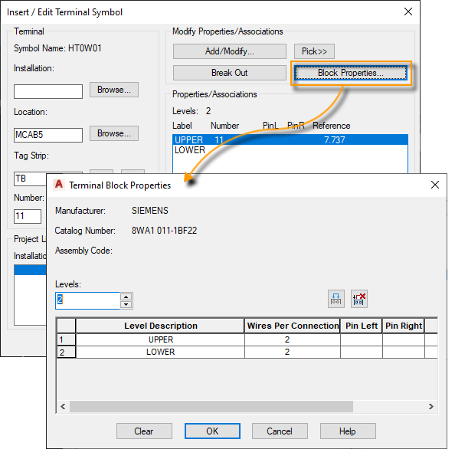
TOPIC 02 · TERMINALS
Terminal Block Properties
• A schematic terminal symbol represents a single-level terminal or ONE level of a multi-level terminal.
• The number of levels is a block property; each level carries its own wiring data.
• View and edit properties in the Insert/Edit Terminal Symbol dialog.
• Associate schematic terminals across levels — and manage whole strips in the Terminal Strip Editor.
Technical Drawing with AutoCAD Electrical · TGS-2023037466
© 2026 Tertiary Infotech Academy Pte Ltd
61

Slide 63
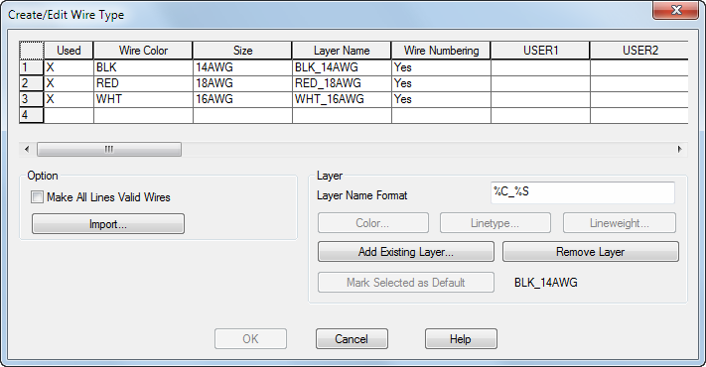
TOPIC 02 · WIRING · K4
Wires and Wire Layers
• A wire is a line object on a layer defined as a wire layer; a wire network is connected wire segments.
• Manage wire layers in a grid: edit colour and size inline, right-click to rename.
• Create layers for wire families (24VDC, 230VAC, earth) so wiring intent is visible at a glance.
Technical Drawing with AutoCAD Electrical · TGS-2023037466
© 2026 Tertiary Infotech Academy Pte Ltd
62

Slide 64
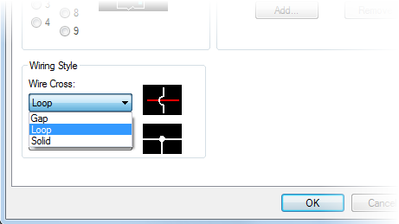
TOPIC 02 · WIRING
Insert Wires
• Inserted wires land on a wire layer automatically — joining an existing wire adopts that wire's layer.
• A tee connection receives a dot or angled tee per the Styles tab of Drawing Properties.
• Change/Convert Wire Type moves wires to another layer or converts plain lines into wires.
Technical Drawing with AutoCAD Electrical · TGS-2023037466
© 2026 Tertiary Infotech Academy Pte Ltd
63

Slide 65
TOPIC 02 · STANDARDS · K4
Wire Number Setup
• The Wire Numbers tab of Drawing Properties defines the wire-number format, type and placement.
• The format mixes text and replaceable parameters: %N (number), %S (sheet), %D (drawing), %X (suffix position), %P/%I/%L (IEC project / installation / location codes).
• Wire numbering is a specification — every sheet in the set must follow the same format.
Technical Drawing with AutoCAD Electrical · TGS-2023037466
© 2026 Tertiary Infotech Academy Pte Ltd
64

Slide 66
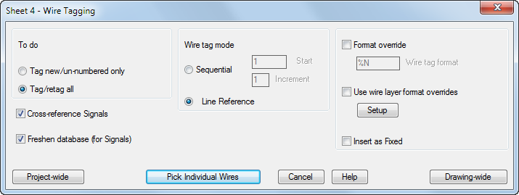
TOPIC 02 · WIRING · A3
Insert Wire Numbers
• The Wire Numbers command inserts new numbers or updates existing ones drawing- or project-wide.
• Drawing-property settings are preselected; override per run if needed.
• Numbers marked Fixed are preserved by renumbering — edit them via Edit Wire Number.
Technical Drawing with AutoCAD Electrical · TGS-2023037466
© 2026 Tertiary Infotech Academy Pte Ltd
65

Slide 67
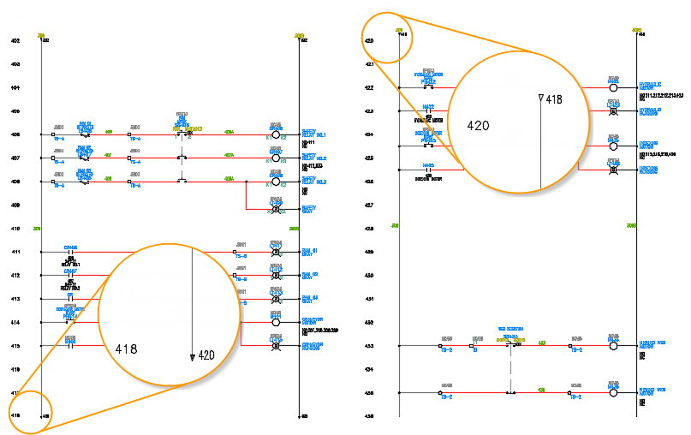
TOPIC 02 · MULTI-SHEET WIRING
Signal Arrows
• A signal arrow breaks a wire network and continues it elsewhere — same drawing or another sheet.
• AutoCAD Electrical uses named source/destination pairs: give the source a code, then insert destinations that reference it.
• Arrows carry cross-reference annotation both ways, so a checker can trace the signal across the set.
Technical Drawing with AutoCAD Electrical · TGS-2023037466
© 2026 Tertiary Infotech Academy Pte Ltd
66

Slide 68
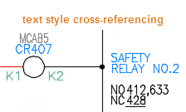
TOPIC 02 · REVIEW FOR ACCURACY · A3
Cross-Referencing
• Cross-references annotate related components with each other's reference locations.
• Three annotation styles on a parent; child annotation is always text format.
• Signal arrows are cross-referenced too — source shows destinations, destination shows its source.
• Set the format and style on Drawing Properties → Cross-References; keep it current before any review or PDF publish.
Technical Drawing with AutoCAD Electrical · TGS-2023037466
© 2026 Tertiary Infotech Academy Pte Ltd
67

Slide 69
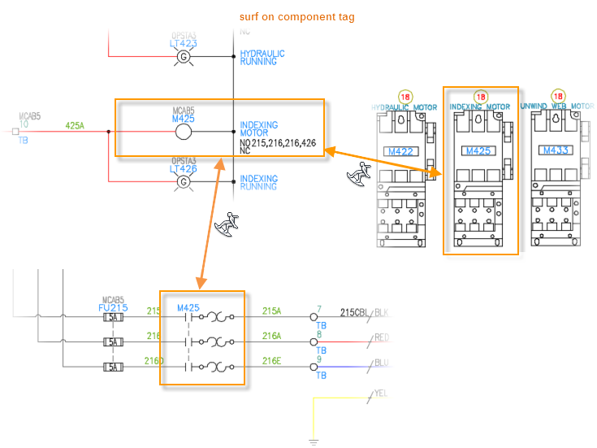
TOPIC 02 · REVIEW FOR ACCURACY · A3
Surfing Between Components
• Surfer jumps between related components and follows signal arrows across drawings.
• Pick a parent and surf to each child, or follow a source arrow to its destinations.
• Surfing is the fastest way to audit that parents, children and signals all agree.
Technical Drawing with AutoCAD Electrical · TGS-2023037466
© 2026 Tertiary Infotech Academy Pte Ltd
68

Slide 70
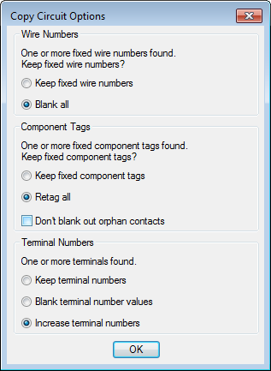
TOPIC 02 · MODIFY · A2
Modify Commands — Edit Without Breaking Intelligence
• Always modify with the Electrical editing commands so component intelligence survives.
• Align components; Move — tags update, wires heal and break as needed.
• Copy with multiple insertion points — tags stay unique; optionally update terminal numbers.
• Circuit Clipboard (Cut/Copy/Paste) moves components and wires between drawings.
• Quick edits: delete-and-heal, toggle NO/NC contact state, swap a block.
Technical Drawing with AutoCAD Electrical · TGS-2023037466
© 2026 Tertiary Infotech Academy Pte Ltd
69

Slide 71
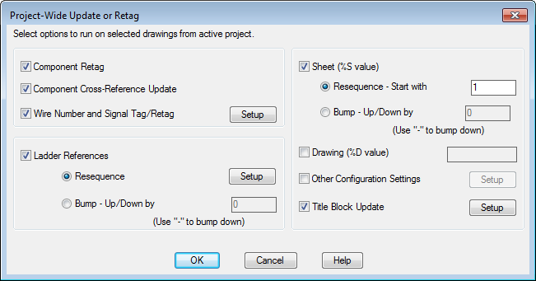
TOPIC 02 · REUSE AT SCALE · A4
Project-Wide Updates
• Reusing drawings from a previous design? Update the reference system, retag components, reassign wire numbers and refresh cross-references in ONE pass.
• Project-Wide Update/Retag runs across every non-reference drawing in the project.
• This is what keeps a copied design consistent instead of quietly wrong.
Technical Drawing with AutoCAD Electrical · TGS-2023037466
© 2026 Tertiary Infotech Academy Pte Ltd
70

Slide 72
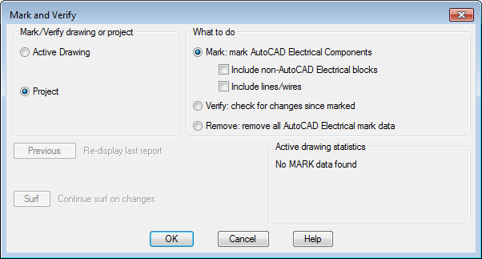
TOPIC 02 · CHANGE CONTROL · A3
Track Changes — Mark and Verify
• Mark/Verify tracks changes to your drawings — even changes made outside AutoCAD Electrical.
• Mark records the current state before edits begin.
• Verify afterwards reports every change — print it or surf straight to each changed object.
• A marked-and-verified set gives the reviewer an exact change list to check against the specification.
Technical Drawing with AutoCAD Electrical · TGS-2023037466
© 2026 Tertiary Infotech Academy Pte Ltd
71

Slide 73
WHAT YOU'LL DO
Hands-On Labs — Topic 2
Lab 3
Lab 4
Lab 5
• Build Circuits with Circuit Builder
• A schematic sheet containing a Circuit Builder motor circuit plus a saved, reusable circuit block.
• Insert Wires, Wire Numbers and Terminals
• A correctly wired and wire-numbered circuit with terminals, matching the drawing's wire-number specification.
• Cross-Reference and Surf a Drawing Set
• A cross-referenced two-sheet circuit you can navigate with Surfer, plus a Mark/Verify change report.
Technical Drawing with AutoCAD Electrical · TGS-2023037466
© 2026 Tertiary Infotech Academy Pte Ltd
72

Slide 74
TOPIC 02 · HANDS-ON
Build Circuits with Circuit Builder
LAB 3
Use Circuit Builder to insert a three-phase motor-control circuit built dynamically from your selections, then save a frequently used circuit and re-insert it from the icon menu.
You'll build
A schematic sheet containing a Circuit Builder motor circuit plus a saved, reusable circuit block.
Tools: Circuit Builder · Icon Menu · Schematic components · Saved circuits
Technical Drawing with AutoCAD Electrical · TGS-2023037466
© 2026 Tertiary Infotech Academy Pte Ltd
73

Slide 75
LAB 3 · STEP BY STEP
STEPS 1–4 OF 6
Build Circuits with Circuit Builder
Open the supplied blank sheet 2-0_Blank.dwg inside your TRAINING project and insert a ladder to carry the circuit.
AELADDER
1
Launch Circuit Builder from the Schematic tab and pick a 3-phase motor circuit from the tree.
AECIRCBUILDER
2
Step through the Circuit Configuration dialog — select the disconnect, protection and control options; the circuit is built dynamically from your selections.
Circuit Builder → Configure → Insert
3
Insert a push button and a selector switch from the Icon Menu to complete the control rung.
AECOMPONENT (Icon Menu)
4
Technical Drawing with AutoCAD Electrical · TGS-2023037466
© 2026 Tertiary Infotech Academy Pte Ltd
74

Slide 76
LAB 3 · STEP BY STEP
STEPS 5–6 OF 6
Build Circuits with Circuit Builder
Select the finished circuit and save it with Save Circuit to Icon Menu for reuse.
5
Schematic → Circuit Clipboard → Save Circuit
Insert the saved circuit onto a clear area of the sheet and watch tags update to stay unique.
6
Icon Menu → Saved Circuits
Technical Drawing with AutoCAD Electrical · TGS-2023037466
© 2026 Tertiary Infotech Academy Pte Ltd
75

Slide 77
LAB 3 · VERIFY
Build Circuits with Circuit Builder
✅ Test it
The motor circuit sits on the ladder with unique component tags (M1, PB1 …), and your saved circuit re-inserts with automatically retagged components — construction needs are met without redrawing.
Technical Drawing with AutoCAD Electrical · TGS-2023037466
© 2026 Tertiary Infotech Academy Pte Ltd
76

Slide 78
TOPIC 02 · HANDS-ON
Insert Wires, Wire Numbers and Terminals
LAB 4
Insert wires between components, trim them, add automatic wire numbers in the drawing's specified format, and place schematic terminals — the accuracy checks every wiring diagram must pass.
You'll build
A correctly wired and wire-numbered circuit with terminals, matching the drawing's wire-number specification.
Tools: Wires · Wire Numbers · Trim Wire · Schematic Terminals · Power Plan DWG
Technical Drawing with AutoCAD Electrical · TGS-2023037466
© 2026 Tertiary Infotech Academy Pte Ltd
77

Slide 79
LAB 4 · STEP BY STEP
STEPS 1–4 OF 7
Insert Wires, Wire Numbers and Terminals
Continue on your Lab 3 sheet (keep 10-2_Power_Plan.dwg open as an analysis reference for wiring practice).
OPEN 10-2_Power_Plan.dwg
1
Insert two vertical wires between two horizontal rungs — wires land on the wire layer automatically and tee-dots appear at junctions.
AEWIRE
2
Trim the surplus wire segment with Trim Wire (the connected wires heal).
AETRIM
3
Check the wire-number format on the Drawing Properties → Wire Numbers tab (this is the specification you are wiring to).
AEPROPERTIES → Wire Numbers
4
Technical Drawing with AutoCAD Electrical · TGS-2023037466
© 2026 Tertiary Infotech Academy Pte Ltd
78

Slide 80
LAB 4 · STEP BY STEP
STEPS 5–7 OF 7
Insert Wires, Wire Numbers and Terminals
Insert wire numbers project-wide and note that fixed wire numbers are skipped.
5
AEWIRENO
Insert two schematic terminals from the Icon Menu (TRMS category) where the wires leave the sheet.
6
AECOMPONENT → Terminals
Edit one wire number manually and mark it Fixed, then re-run wire numbering to confirm it is preserved.
7
AEEDITWIRENO
Technical Drawing with AutoCAD Electrical · TGS-2023037466
© 2026 Tertiary Infotech Academy Pte Ltd
79

Slide 81
LAB 4 · VERIFY
Insert Wires, Wire Numbers and Terminals
✅ Test it
Every wire carries a number in the drawing-property format, the fixed number survives a project-wide renumber, and the terminals join the wires cleanly — the sheet passes an accuracy review.
Technical Drawing with AutoCAD Electrical · TGS-2023037466
© 2026 Tertiary Infotech Academy Pte Ltd
80

Slide 82
TOPIC 02 · HANDS-ON
Cross-Reference and Surf a Drawing Set
LAB 5
Link a parent coil to its child contacts, break a wire across sheets with source/destination signal arrows, then audit the set with Surfer and Mark/Verify — how a checker reviews a real drawing set.
You'll build
A cross-referenced two-sheet circuit you can navigate with Surfer, plus a Mark/Verify change report.
Tools: Cross-referencing · Signal Arrows · Surfer · Mark/Verify · Reference DWG
Technical Drawing with AutoCAD Electrical · TGS-2023037466
© 2026 Tertiary Infotech Academy Pte Ltd
81

Slide 83
LAB 5 · STEP BY STEP
STEPS 1–4 OF 6
Cross-Reference and Surf a Drawing Set
Insert a relay coil (parent) on sheet 1 and a NO contact (child) on sheet 2 of your project; assign the child to the parent in the Insert/Edit Child dialog.
AECOMPONENT → coil / contact
1
Update cross-references and read the parent's contact grid — it reports where every child lives.
AEXREF
2
Break a wire network across the two sheets with a Source arrow (assign a code) and a matching Destination arrow.
AESOURCE · AEDEST
3
Right-click the coil and Surf: jump between the parent, children and signal arrows from the Surf list.
AESURF
4
Technical Drawing with AutoCAD Electrical · TGS-2023037466
© 2026 Tertiary Infotech Academy Pte Ltd
82

Slide 84
LAB 5 · STEP BY STEP
STEPS 5–6 OF 6
Cross-Reference and Surf a Drawing Set
Mark the project (Mark/Verify), move one component, then run Verify to get the change report.
5
AEMARKVERIFY
Open the supplied reference drawings and identify which sheets are reference-only in Project Manager.
6
OPEN 10-1_Working_with_References.dwg
Technical Drawing with AutoCAD Electrical · TGS-2023037466
© 2026 Tertiary Infotech Academy Pte Ltd
83

Slide 85
LAB 5 · VERIFY
Cross-Reference and Surf a Drawing Set
✅ Test it
Surfer jumps coil → contact → signal arrow across sheets without manual searching, and the Verify report lists exactly the one component you moved — the set is auditable for accuracy.
Technical Drawing with AutoCAD Electrical · TGS-2023037466
© 2026 Tertiary Infotech Academy Pte Ltd
84

Slide 86
TOPIC RECAP
Recap — Topic 2
• A4 — analyse drawings to determine construction needs; assemble standard motor-control circuits (Lab 3)
• A3 — review drawings for accuracy; wire the circuit and number it to specification (Lab 4)
• A3, A4 — review a multi-sheet set for accuracy with cross-references, Surfer and signal arrows (Lab 5)
• Key concepts: Types of technical drawings, Technical drawing standards, Schematic components, Terminals & PLC symbols, Wires, numbers & arrows, Review for accuracy.
Technical Drawing with AutoCAD Electrical · TGS-2023037466
© 2026 Tertiary Infotech Academy Pte Ltd
85

Slide 87
SEE YOU TOMORROW · 0930
End of Day 1
Day 2 continues with drawing-set review, documentation, submission — and the final assessment.
Technical Drawing with AutoCAD Electrical · TGS-2023037466
© 2026 Tertiary Infotech Academy Pte Ltd
86

Slide 88
Day 2
Digital attendance (AM) · Day 1 recap

Slide 89
03
TOPIC 03
Reviewing Technical Drawings for Strategic Relevance and Standard Compliance
Drafting documentation · panel layouts · reports & part lists · custom symbols · plot & publish for submission (K5, K6 · A5, A6)
Technical Drawing with AutoCAD Electrical · TGS-2023037466
© 2026 Tertiary Infotech Academy Pte Ltd
88

Slide 90
MAPS TO LO3
Key Concepts — Topic 3
Fundamentals of documentation
Panel layouts, nameplates, item numbers and balloons turn a schematic into build documentation. (K5)
Reports & part lists
BOM, wire from/to and component reports extract project data for checking and procurement.
1
2
Custom symbols
Symbol Builder creates house-standard symbols so drawings match the organisation's conventions. (K6)
Strategic relevance
Reuse projects, track changes and align drawing sets with the organisation's design strategies. (A5)
3
4
Standard compliance
Title blocks, xrefs and plot standards keep sheets conformant to submission requirements. (A6)
Plot & publish
Output the project to a printer or a hyperlinked multi-sheet PDF for stakeholder submission.
5
6
Technical Drawing with AutoCAD Electrical · TGS-2023037466
© 2026 Tertiary Infotech Academy Pte Ltd
89

Slide 91
TOPIC 03 · DOCUMENTATION · K5
Fundamentals of Drafting Design Documentation
• A schematic alone cannot be built: documentation adds the physical and procurement views.
• Panel layouts show where each device mounts; nameplates label them; item numbers and balloons key parts to the BOM.
• Reports extract part lists, wire lists and terminal plans from the same project data — no retyping.
• Documentation must align with the organisation's strategies (house symbols, formats) and submission standards. (A5, A6)
Technical Drawing with AutoCAD Electrical · TGS-2023037466
© 2026 Tertiary Infotech Academy Pte Ltd
90

Slide 92
TOPIC 03 · DOCUMENTATION · K5
Panel Layouts
• Insert panel footprint symbols from the schematic component list or the panel icon menu.
• The PANEL ribbon tab carries the layout tools; drawing properties hold panel-specific settings.
• Add components and connect with the insert tools; nameplates, item numbers and balloons complete the layout.
Technical Drawing with AutoCAD Electrical · TGS-2023037466
© 2026 Tertiary Infotech Academy Pte Ltd
91

Slide 93
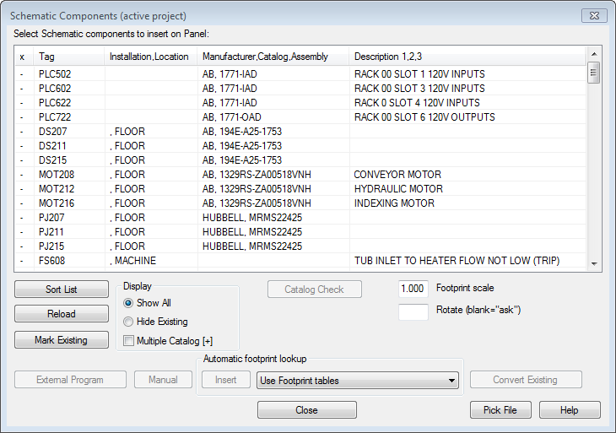
TOPIC 03 · SCHEMATIC → PANEL
Insert Footprints from the Schematic List
• Draw schematics first, then build the panel by selecting from the schematic component list.
• The catalog assignment finds the correct footprint; browse or draw one on the fly if missing.
• The dialog shows which components are already placed; all values copy from schematic to footprint.
• Change a value on either side later and the other side updates — schematic and panel stay consistent.
Technical Drawing with AutoCAD Electrical · TGS-2023037466
© 2026 Tertiary Infotech Academy Pte Ltd
92

Slide 94
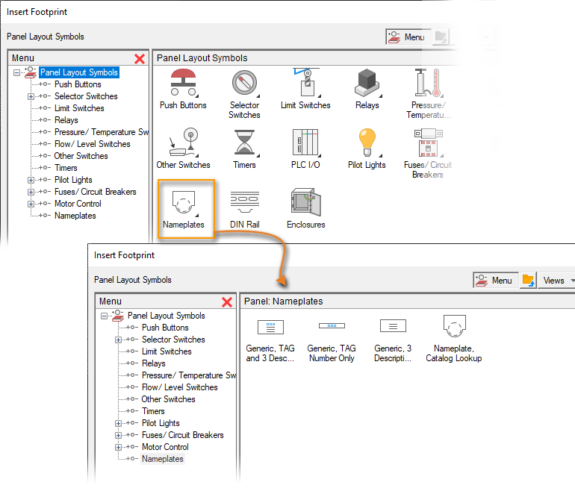
TOPIC 03 · DOCUMENTATION
Panel Icon Menu and Nameplates
• Components not on the schematic (wire duct, rails) insert from the Panel Icon Menu.
• Insert nameplates from the icon menu and associate each with a footprint.
• Tag, installation, location and descriptions copy from the footprint — override if required.
Technical Drawing with AutoCAD Electrical · TGS-2023037466
© 2026 Tertiary Infotech Academy Pte Ltd
93

Slide 95
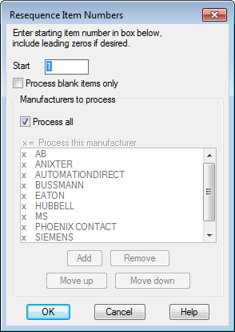
TOPIC 03 · BOM KEYING · K5
Item Numbers and Balloons
• Item numbers key parts to the BOM; components sharing a catalog value share an item number.
• Panel components are numbered first, then schematic components.
• Set the item-numbering project properties before resequencing.
• Insert balloons to make item numbers visible; multi-catalog components prompt for which value to balloon.
Technical Drawing with AutoCAD Electrical · TGS-2023037466
© 2026 Tertiary Infotech Academy Pte Ltd
94

Slide 96
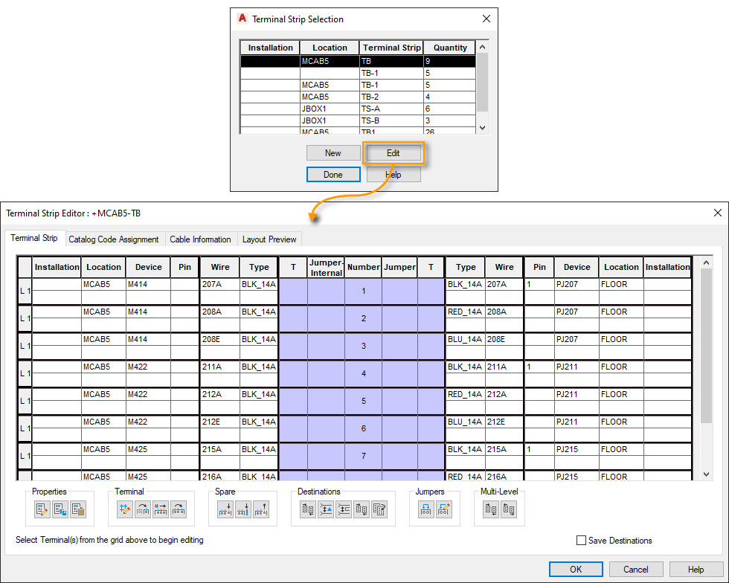
TOPIC 03 · TERMINAL PLANS
Terminal Strip Editor
• Manage an entire terminal strip at once: catalog values, connected components, wires and numbers.
• Resequence terminal numbers, reorder terminals, add spares and accessories, insert jumpers.
• The strip list merges panel terminals and schematic terminals into one editable view.
• Insert the strip graphically — or generate tabular terminal strips with the Table Generator.
Technical Drawing with AutoCAD Electrical · TGS-2023037466
© 2026 Tertiary Infotech Academy Pte Ltd
95

Slide 97
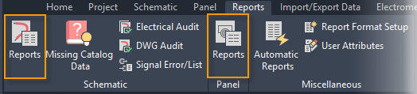
TOPIC 03 · PART LISTS · K5
Reports
• Generate project reports: Bill of Material, component lists, wire from/to, terminal plans and more.
• The REPORT command builds custom reports from drawing data; select the report, options and drawings to process.
• Output to a file for procurement, or insert on the drawing as a table for the construction set.
Technical Drawing with AutoCAD Electrical · TGS-2023037466
© 2026 Tertiary Infotech Academy Pte Ltd
96

Slide 98
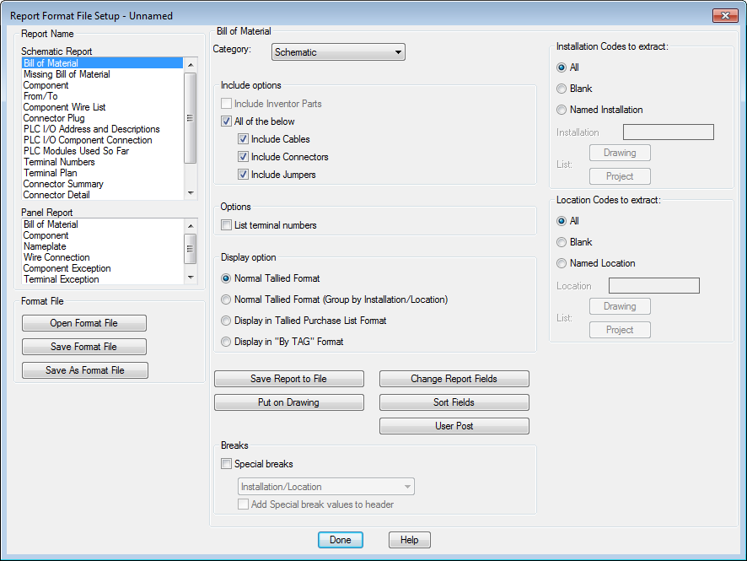
TOPIC 03 · HOUSE STANDARDS · A5
Report Fields and Format Files
• After running a report, include/exclude fields, reorder them and rename labels.
• Save the settings as a .SET format file — unlimited format files per report type.
• Format files ARE the organisation's reporting standard: everyone reproduces the same layout in one click.
• Automatic Reports runs a whole group of formatted reports in a single pass.
Technical Drawing with AutoCAD Electrical · TGS-2023037466
© 2026 Tertiary Infotech Academy Pte Ltd
97

Slide 99
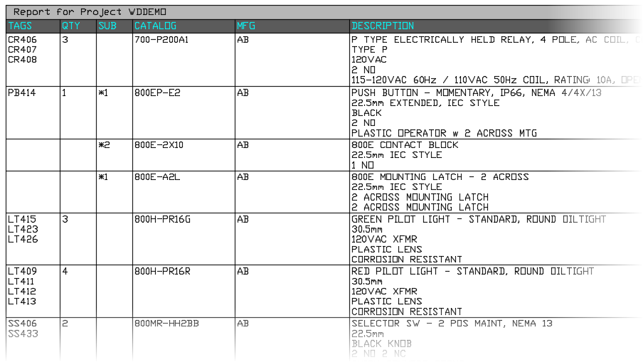
TOPIC 03 · PART LISTS
Output a Report — File or Drawing Table
• Save to File exports the report (CSV, XLS, MDB) for procurement and checking.
• Put on Drawing inserts the report as an AutoCAD table — style it with TABLESTYLE.
• The drawing table and the exported file come from the same data, so they cannot disagree.
Technical Drawing with AutoCAD Electrical · TGS-2023037466
© 2026 Tertiary Infotech Academy Pte Ltd
98

Slide 100
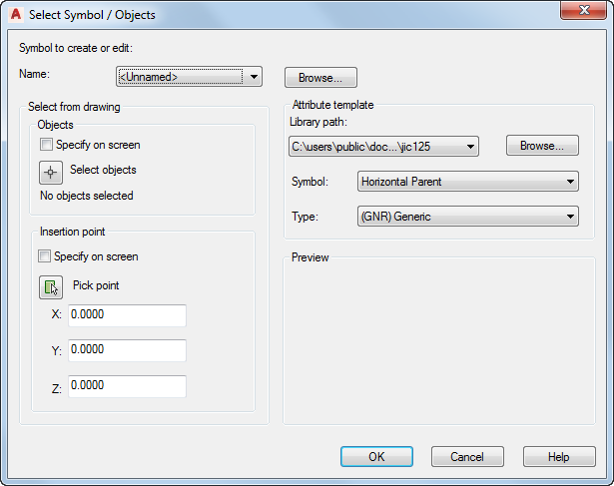
TOPIC 03 · IT CONCEPTS · K6
Custom Symbols with Symbol Builder
• Symbol Builder creates custom symbols fully compatible with AutoCAD Electrical.
• Start from scratch or from a similar existing symbol; set symbol type, insertion point and orientation.
• For schematic symbols create both the parent and child versions.
• Draw the graphics, then save following the AutoCAD Electrical symbol naming convention — that is what makes the symbol intelligent.
Technical Drawing with AutoCAD Electrical · TGS-2023037466
© 2026 Tertiary Infotech Academy Pte Ltd
99

Slide 101
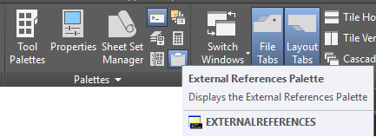
TOPIC 03 · COMPOSITION · K6
External References (Xrefs)
• An external reference attaches another file into the current drawing without copying it.
• The External References palette organises DWG, DWF, DGN, PDF and image references.
• Attach via the palette (View tab → Palettes) or the XREF command; pick the file and placement.
• Xrefs keep shared content (title blocks, outlines) in ONE file — edit once, update everywhere.
Technical Drawing with AutoCAD Electrical · TGS-2023037466
© 2026 Tertiary Infotech Academy Pte Ltd
100

Slide 102
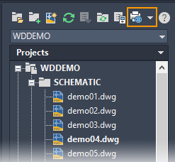
TOPIC 03 · SUBMISSION · A6
Plot a Project
• Print an entire project, a subset of sheets, or a single drawing.
• Use Publish/Plot on Project Manager → Plot Project, then pick the drawings to output.
• Select the layout to plot per drawing; use a named page setup for consistent output.
• Map a plot date/time attribute in the title block — it stamps automatically at plot time.
Technical Drawing with AutoCAD Electrical · TGS-2023037466
© 2026 Tertiary Infotech Academy Pte Ltd
101

Slide 103
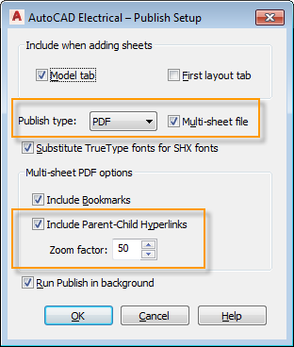
TOPIC 03 · SUBMISSION · A6
Publish to a Hyperlinked PDF
• Publish the project to a multi-sheet PDF that preserves relationships as hyperlinks.
• Tick Multi-sheet file and Include Hyperlinks; the zoom factor sets how close a clicked link zooms.
• Each object carries one hyperlink — reach a child through the parent's cross-reference text.
• Update cross-referencing BEFORE publishing; then reviewers can navigate the set without AutoCAD.
Technical Drawing with AutoCAD Electrical · TGS-2023037466
© 2026 Tertiary Infotech Academy Pte Ltd
102

Slide 104
WHAT YOU'LL DO
Hands-On Labs — Topic 3
Lab 6
Lab 7
Lab 8
• Create a Panel Layout with Footprints
• A panel layout drawing with footprints placed from the schematic list, a nameplate, item numbers and balloons.
• Generate Reports and Part Lists
• A BOM table placed on the drawing plus a saved .SET format file and a CSV export of the report.
• Plot and Publish the Project to PDF
• An A3 PDF plot of one sheet and a hyperlinked multi-sheet PDF of the whole project.
Technical Drawing with AutoCAD Electrical · TGS-2023037466
© 2026 Tertiary Infotech Academy Pte Ltd
103

Slide 105
TOPIC 03 · HANDS-ON
Create a Panel Layout with Footprints
LAB 6
Generate a panel layout from the schematic component list, insert footprints and a nameplate, and assign item numbers with balloons — drafting design documentation the workshop can build from.
You'll build
A panel layout drawing with footprints placed from the schematic list, a nameplate, item numbers and balloons.
Tools: Panel tab · Schematic List · Footprints · Nameplates · Item balloons · Blocks DWGs
Technical Drawing with AutoCAD Electrical · TGS-2023037466
© 2026 Tertiary Infotech Academy Pte Ltd
104

Slide 106
LAB 6 · STEP BY STEP
STEPS 1–4 OF 6
Create a Panel Layout with Footprints
Create a new panel drawing in your project and switch to the Panel tab of the ribbon.
New Drawing → Panel tab
1
Insert footprints from the schematic list — AutoCAD Electrical matches each component's catalog value to a footprint.
AEFOOTPRINT (Schematic List)
2
Place the footprints inside the panel outline; values (tag, location, description) copy over from the schematic.
Pick insertion points
3
Insert a nameplate from the Panel icon menu and associate it with a footprint.
Panel Icon Menu → Nameplate
4
Technical Drawing with AutoCAD Electrical · TGS-2023037466
© 2026 Tertiary Infotech Academy Pte Ltd
105

Slide 107
LAB 6 · STEP BY STEP
STEPS 5–6 OF 6
Create a Panel Layout with Footprints
Assign item numbers project-wide — components with the same catalog value receive the same item number.
5
AEPANELITEM
Add item balloons to the footprints and study the supplied blocks/attributes drawings to see how footprint blocks carry data.
6
AEBALLOON
Technical Drawing with AutoCAD Electrical · TGS-2023037466
© 2026 Tertiary Infotech Academy Pte Ltd
106

Slide 108
LAB 6 · VERIFY
Create a Panel Layout with Footprints
✅ Test it
Each footprint shows the same tag as its schematic parent, the nameplate carries the footprint's description, and balloons display consistent item numbers — the panel documents the design faithfully.
Technical Drawing with AutoCAD Electrical · TGS-2023037466
© 2026 Tertiary Infotech Academy Pte Ltd
107

Slide 109
TOPIC 03 · HANDS-ON
Generate Reports and Part Lists
LAB 7
Run Bill of Material and Wire From/To reports across the project, tailor the fields, save a format file for repeat use, and insert the report as a table on the drawing — the part lists a checker reviews.
You'll build
A BOM table placed on the drawing plus a saved .SET format file and a CSV export of the report.
Tools: Reports · Bill of Material · Format files (.SET) · Tables · Attributes DWG
Technical Drawing with AutoCAD Electrical · TGS-2023037466
© 2026 Tertiary Infotech Academy Pte Ltd
108

Slide 110
LAB 7 · STEP BY STEP
STEPS 1–4 OF 6
Generate Reports and Part Lists
Run the Reports tool on the Reports tab and choose Bill of Material, processing the whole project.
AEAUDIT → Reports → BOM
1
Adjust the report: include/exclude fields, reorder columns and rename field labels to your house standard.
Change Report Fields
2
Save the settings as a format file so the same report can be re-run in one click next time.
Save Format File (.SET)
3
Insert the report on the drawing as a table (Put on Drawing) using a table style.
Put on Drawing · TABLESTYLE
4
Technical Drawing with AutoCAD Electrical · TGS-2023037466
© 2026 Tertiary Infotech Academy Pte Ltd
109

Slide 111
LAB 7 · STEP BY STEP
STEPS 5–6 OF 6
Generate Reports and Part Lists
Export the same report to a file for procurement (CSV/XLS).
5
Save to File → CSV
Run a Wire From/To report and compare it against the wiring you created in Lab 4; open the supplied table drawings to see linked tables.
6
Reports → Wire From/To
Technical Drawing with AutoCAD Electrical · TGS-2023037466
© 2026 Tertiary Infotech Academy Pte Ltd
110

Slide 112
LAB 7 · VERIFY
Generate Reports and Part Lists
✅ Test it
The BOM table on the drawing matches the CSV export line for line, and re-running the report through your .SET format file reproduces the same layout — the part list is standard-compliant and repeatable.
Technical Drawing with AutoCAD Electrical · TGS-2023037466
© 2026 Tertiary Infotech Academy Pte Ltd
111

Slide 113
TOPIC 03 · HANDS-ON
Plot and Publish the Project to PDF
LAB 8
Attach an external reference, then plot a drawing to an A3 PDF and publish the whole project to a single multi-sheet PDF with hyperlinks — the final conformance step before submission.
You'll build
An A3 PDF plot of one sheet and a hyperlinked multi-sheet PDF of the whole project.
Tools: External References · Plot · Publish · Multi-sheet PDF · Layout tabs DWG
Technical Drawing with AutoCAD Electrical · TGS-2023037466
© 2026 Tertiary Infotech Academy Pte Ltd
112

Slide 114
LAB 8 · STEP BY STEP
STEPS 1–4 OF 6
Plot and Publish the Project to PDF
Open the External References palette and attach a DWG as an xref to see how reference files are managed.
XREF → Attach DWG
1
Open 1-12_Using_Layout_Tabs.dwg and review its layout tabs — plotting always happens from a layout with a page setup.
OPEN → Layout tabs
2
Plot the active drawing to PDF at A3 size from the Plot dialog (printer: AutoCAD PDF, paper: ISO A3).
PLOT → AutoCAD PDF → ISO A3
3
From Project Manager, choose Publish/Plot → Plot Project and select the sheets to output.
Project Manager → Plot Project
4
Technical Drawing with AutoCAD Electrical · TGS-2023037466
© 2026 Tertiary Infotech Academy Pte Ltd
113

Slide 115
LAB 8 · STEP BY STEP
STEPS 5–6 OF 6
Plot and Publish the Project to PDF
Publish the project to a single multi-sheet PDF with Include Hyperlinks checked — cross-references become clickable links.
5
AEPUBLISH → Multi-sheet · Hyperlinks
Open the PDF and click a parent's cross-reference to jump to its child; confirm the title block shows the plot date.
6
Verify in PDF viewer
Technical Drawing with AutoCAD Electrical · TGS-2023037466
© 2026 Tertiary Infotech Academy Pte Ltd
114

Slide 116
LAB 8 · VERIFY
Plot and Publish the Project to PDF
✅ Test it
The A3 PDF matches the layout exactly, and in the multi-sheet PDF clicking a cross-reference hyperlink jumps to the referenced component — the set is ready for standards-conformant submission.
Technical Drawing with AutoCAD Electrical · TGS-2023037466
© 2026 Tertiary Infotech Academy Pte Ltd
115

Slide 117
TOPIC RECAP
Recap — Topic 3
• A5 — turn the schematic into build documentation aligned with the organisation's design strategy (Lab 6)
• A6, K5 — extract BOM and wire lists, format them to house standards and place them on the drawing (Lab 7)
• A6 — output the drawing set to submission standards (A3 sheets, hyperlinked multi-sheet PDF) (Lab 8)
• Key concepts: Fundamentals of documentation, Reports & part lists, Custom symbols, Strategic relevance, Standard compliance, Plot & publish.
Technical Drawing with AutoCAD Electrical · TGS-2023037466
© 2026 Tertiary Infotech Academy Pte Ltd
116

Slide 118
WRAP-UP
Course Summary & Assessment
Technical Drawing with AutoCAD Electrical · TGS-2023037466
© 2026 Tertiary Infotech Academy Pte Ltd
117

Slide 119
LEARNING OUTCOMES DELIVERED
What You Achieved
Set up to standard
Configured drawings from templates with limits, units, grid and snap — production metrics in force. (A1)
Projects & drawings
Built .wdp projects, managed drawing order, properties and reference-only sheets. (A1, A2)
1
2
Schematic drawing
Inserted components, circuits, terminals and PLC modules to IEC/IEEE/NFPA standards. (K1, K3)
Wired & numbered
Wired circuits with layered wires, spec-format wire numbers and signal arrows. (K4, A3)
3
4
Reviewed drawing sets
Audited accuracy with cross-references, Surfer and Mark/Verify. (A3, A4)
Documented & submitted
Produced panel layouts, BOM reports, custom symbols and hyperlinked PDF submissions. (K5, K6, A5, A6)
5
6
Technical Drawing with AutoCAD Electrical · TGS-2023037466
© 2026 Tertiary Infotech Academy Pte Ltd
118

Slide 120
TEST YOURSELF
Practice Exam
• Sharpen your readiness with the Tertiary Infotech practice exam portal.
• Practice exams: https://exams.tertiaryinfotech.com/
• Attempt it under timed conditions and review every explanation.
• Revisit any lab whose topic you miss, then re-attempt.
Technical Drawing with AutoCAD Electrical · TGS-2023037466
© 2026 Tertiary Infotech Academy Pte Ltd
119

Slide 121
CONTINUE YOUR LEARNING · TERTIARYCOURSES.COM.SG
Recommended Courses
WSQ - Technical Drawing with AutoCAD
WSQ - Technical Drawing with AutoCAD Mechanical
1
2
WSQ - Application of BIM using Revit
WSQ - Architecture Drawing with Revit
3
4
WSQ - Product Design with Fusion 360
WSQ - AutoCAD Civil 3D for Infrastructure Design
5
6
Technical Drawing with AutoCAD Electrical · TGS-2023037466
© 2026 Tertiary Infotech Academy Pte Ltd
120

Slide 122
WE'RE HERE TO HELP
Support
• If you have any enquiries during and after the class, contact us:
• Email: enquiry@tertiaryinfotech.com
• Tel: +65 6100 0613
• Website: www.tertiarycourses.com.sg
Technical Drawing with AutoCAD Electrical · TGS-2023037466
© 2026 Tertiary Infotech Academy Pte Ltd
121

Slide 123
FEEDBACK · TRAQOM
Cert & TRAQOM Survey (Mandatory)
• Complete the course feedback and the mandatory SSG TRAQOM survey.
• Your e-certificate is issued via the LMS/TMS portal: https://lms-tms.tertiaryinfotech.com
• The trainer will display the TRAQOM QR code — please complete it before the assessment.
Technical Drawing with AutoCAD Electrical · TGS-2023037466
© 2026 Tertiary Infotech Academy Pte Ltd
122

Slide 124
FINAL ASSESSMENT
Assessment
• Written Assessment (WA) — Short-Answer Questions (SAQ), 1 hour, open book. (K1–K6)
• Practical Performance (PP) — hands-on AutoCAD Electrical tasks, 1 hour, open book. (A1–A6)
• Format: Open Book — slides, Learner Guide and approved materials only.
• Submit your completed scripts to the assessor and sign the Assessment Summary Record.
Technical Drawing with AutoCAD Electrical · TGS-2023037466
© 2026 Tertiary Infotech Academy Pte Ltd
123

Slide 125
ON ASSESSMENT DAY
Assessment Flow
1
2
3
4
5
▶
▶
▶
▶
TRAQOM survey — scan the QR code on the LMS
Assessment digital attendance — scan the SSG QR
Sit WA (SAQ) then PP — open book
Submit your answers on the LMS
Sign the Assessment Summary Record
Technical Drawing with AutoCAD Electrical · TGS-2023037466
© 2026 Tertiary Infotech Academy Pte Ltd
124

Slide 126
TRAQOM · SSG DIGITAL ATTENDANCE
Digital Attendance (Mandatory)
• It is mandatory to take the AM, PM and Assessment digital attendance for WSQ-funded courses.
• The trainer/administrator displays the digital attendance QR code from the SSG portal.
• Scan the QR code with your mobile phone camera and submit your attendance.
• A minimum of 75% attendance is required to be eligible for assessment and funding.
Technical Drawing with AutoCAD Electrical · TGS-2023037466
© 2026 Tertiary Infotech Academy Pte Ltd
125

Slide 127
HAPPY DRAFTING
Thank You!
You are now ready to produce, analyse and review technical drawings with AutoCAD Electrical.
Technical Drawing with AutoCAD Electrical · TGS-2023037466
© 2026 Tertiary Infotech Academy Pte Ltd
126

